Slide 1
Business Intelligence
Introduction

Slide 2
Introduction
Business Intelligence is a discipline that analyzes a company’s data using technologies, such as statistics and machine learning, with the objective of increasing competitiveness.
For example, a big company like Amazon

Slide 3
There are many automatic and semi-automatic tools to manage this huge volume of data.
type of data
Structured
Unstructured data.

Slide 4
The most common repositories that store these data are Data Warehouse and Data Lake.

Slide 5
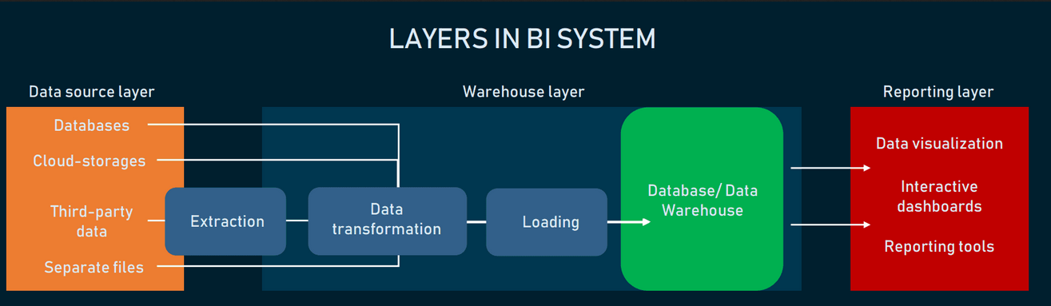

Slide 6
1.1 Business Intelligence and Information Exploitation

Slide 7
Business Intelligence and Information Exploitation
Data vs Information vs BI
Data not only stored within structured data systems, but are captured, stored, managed, shared, and distributed across different file formats, representative structures, and even as unstructured data assets.
power to filter out and deliver the gems of knowledge to the right decision-makers that can trigger the right kinds of choices and actions at the optimal times.

Slide 8
Historically, data is the raw material that fueled operational activities and transaction systems.
Today, different data sets are used and then repurposed multiple times, simultaneously feeding both operational and analytical processes intended to achieve different business objectives.

Slide 9
1.1.1 Improving the Decision-Making Process

Slide 10
Every business process has its associated measures of performance, and in a perfect world, each decision would be the optimal one-the decision whose results lead to the best overall performance.

Slide 11
When large amounts of unfiltered data are made available across the organization, overwhelmed individuals may be stunned into ‘‘analysis paralysis’’
Solutions
overload is reduced by distilling out the specific information
From the comprehensive strategic perspective, the senior management team can review overall company performance
Actionable information informs both strategic and operational processes, and its delivery to staff members up and down the organizational chart

Slide 12
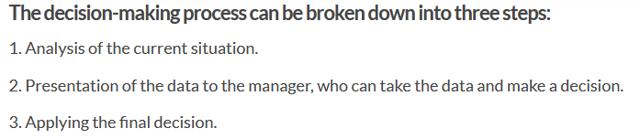

Slide 13
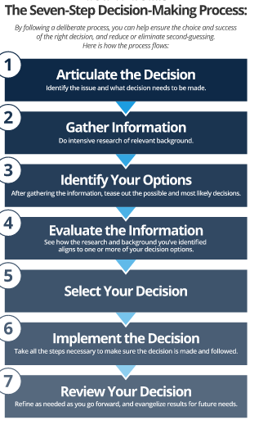

Slide 14
1.1.2 Why a Business Intelligence Program

Slide 15
Business intelligence processes help you organize your data so it can be easily accessed and analyzed.
Decision makers can then dig in and get the information they need quickly, empowering them to make informed decisions.

Slide 16
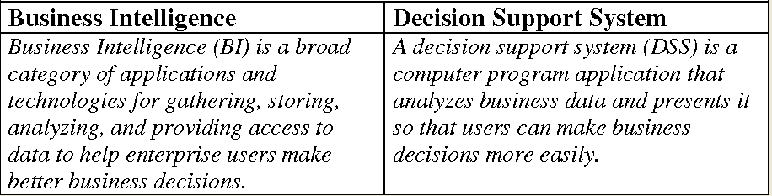

Slide 17
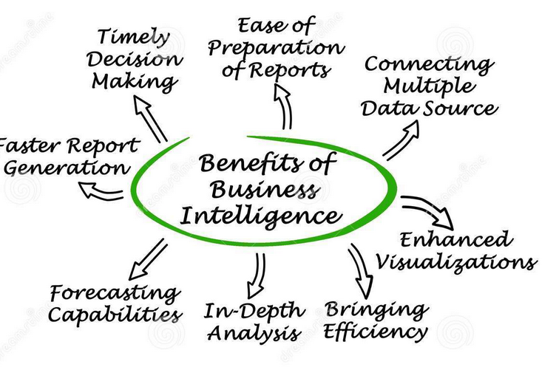

Slide 18
Some benefits are focused on the ability to answer what might be considered the most basic questions about how a company does business.
For
example, it is surprising how few senior managers within a company can answer simple questions about their business, such as:
How many employees do you have?
For each product, how many were sold over the last 12 months within each geographic region?
Who are your 10 best customers?
What is the value of any particular customer?
Who are your 20 best suppliers?

Slide 19
1.1.3 Business Intelligence and Program Success

Slide 20
BI activity: the discovery phase, justification,
analysis of requirements for design, creation, management, maintenance, or development of a BI program.

Slide 21
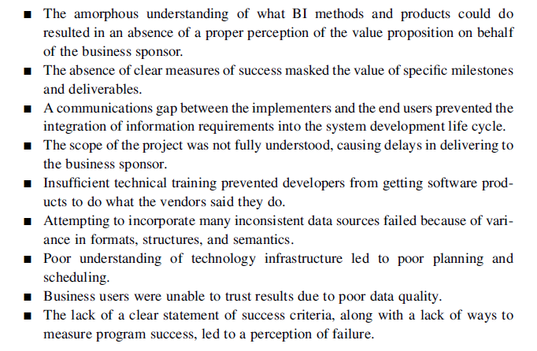

Slide 22
an operational business framework while providing the introductory technical background and highlighting important topics such as:
Management issues
Managing change
Technical issues
Performance issues
Complexity

Slide 23
1.1.4 The Analytics Spectrum

Slide 24
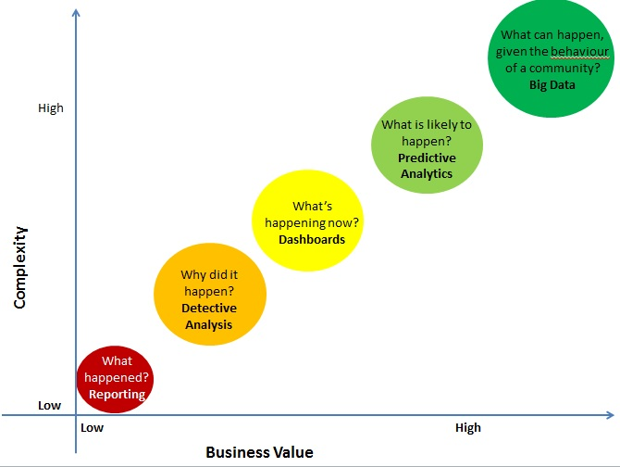

Slide 25
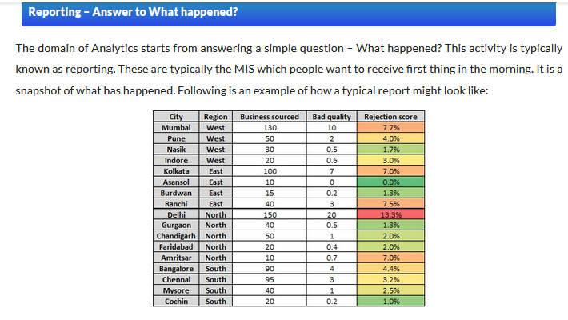

Slide 26
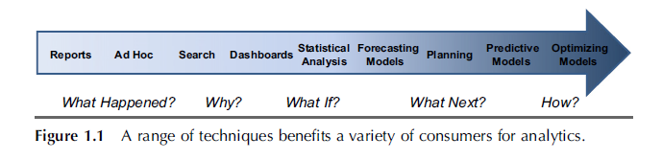

Slide 27
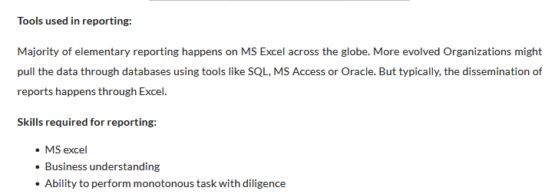

Slide 28
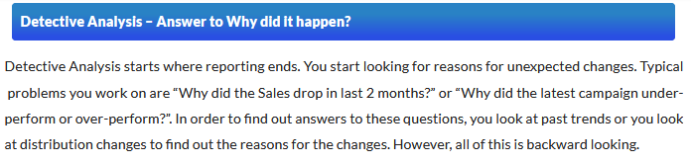

Slide 29
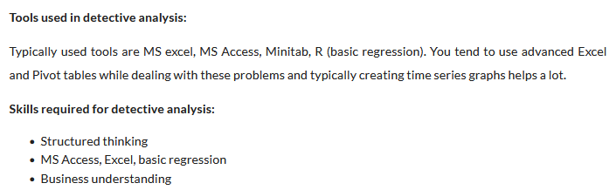

Slide 30
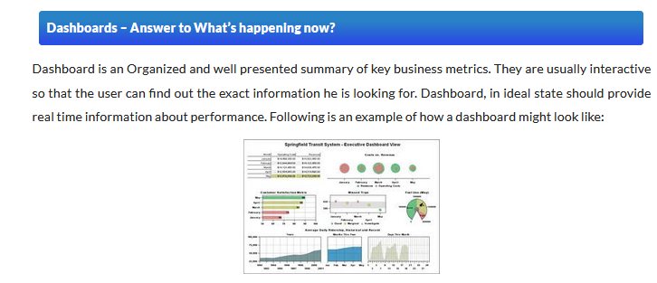

Slide 31
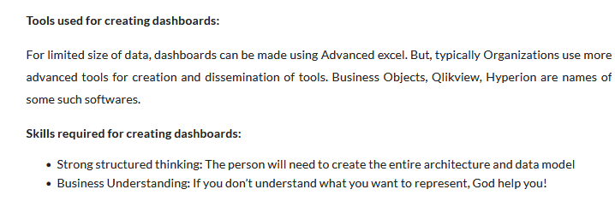

Slide 32
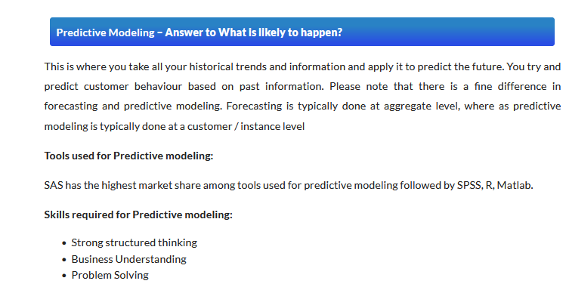

Slide 33
Taming the Information Explosion

Slide 34
Four Steps to Taming the Data Explosion
Start with Policy. As a first step to taming the data explosion, corporates need to apply data management policies. ...
Tame with Technology. ...
Characterize, Classify, Act. ...
Importance of a Documented Process. ...
Benefits of Information Management.

Slide 35
Performance Metrics and Key Performance Indicators

Slide 36
Performance Metrics and Key Performance Indicators
Performance metrics measure how well we perform within a particular business context.
A performance metric relates an objective ‘‘score’’ (with a specific unit of measures) within a subjective scale of success.
Examples: sales, profit, return on investment, customer happiness, customer reviews,etc.,

Slide 37
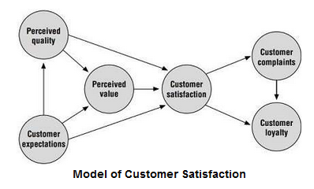
Example

Slide 38
performance metrics are associated with every business process.
The highest level of metric is the key performance indicator (KPI).
KPIs can be collected together to provide a conceptual scorecard for a business and can be associated with a number of different business activities, especially within our four value driver areas such as financial value, productivity, risk, and trust.

Slide 39
Key performance indicators capture the business definitions as part of the corporate knowledge base, and then provide a visualization dashboard that reflects those KPI measurements, presented in a form for management review.

Slide 40
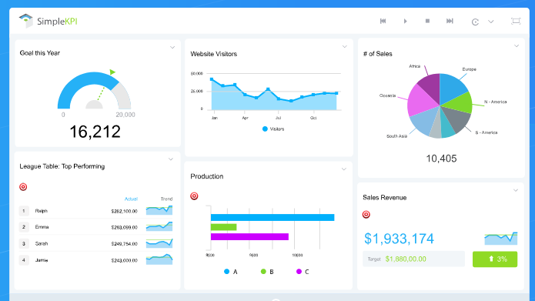

Slide 41
This BI dashboard displays the results of the analytics required to configure the KPIs in a succinct visual representation that can be understood instantaneously or selected for drill-down.
A BI dashboard will not only provide real-time presentation of the selected KPIs, but will also hook directly into the BI components that allow for that drill-down.

Slide 42
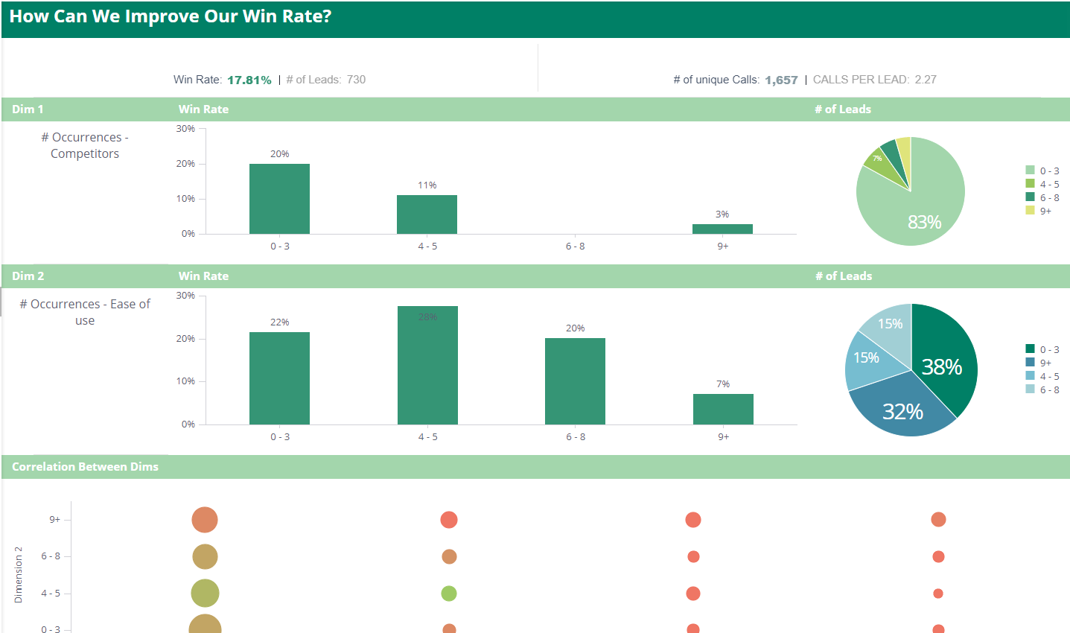
Example : Sales Calls Analysis

Slide 43
sample performance metrics:
Revenue generation via customer profiling and targeted marketing
Risk management via identification of fraud, abuse, and leakage
Improved customer satisfaction via profiling, personalization, and customer lifetime value analysis
Improved procurement and acquisition productivity through spend analysis

Slide 44
Horizontal Use Cases for Business Intelligence

Slide 45
Horizontal Use Cases for Business Intelligence
Customer Analysis
Revenue Generation
Human Resources and Staff Utilization
Product Management, Productivity Analysis, and Cost Management
Operations
Finance and Risk Management
Supply Chain Management
Sales Channel Analytics
Behavior Analysis

Slide 46
1. Customer Analysis
The intent of the original batch of customer relationship management (CRM) applications was to provide a means for capturing information about customer contacts as a way to solidify the company–customer relationship and thereby lead to increased sales, volumes, and satisfaction

Slide 47
Following are different aspects of customer analytics that benefit the sales,marketing, and service organizations as they interact with the customers:
Customer profiling.
Personalization.
Collaborative filtering
Customer satisfaction
Customer lifetime value.
Customer loyalty

Slide 48
Customer Profiling
Companies are realizing that all customers are not clones of some predefined market segment; instead, the characteristics of the ‘‘best customers’’ almost reflect a self-organized categorization.
1) The Psychographic Approach
2) The Consumer Typology Approach
3) The Consumer Characteristics Approach

Slide 49
Personalization
It is the process of crafting a presentation to the customer based on that customer’s profile, is the modern-day counterpart to the old-fashioned salesperson who remembers everything about his or her individual ‘‘accounts.’’

Slide 50
Collaborative filtering
Collaborative filtering (CF) is a technique used by recommender systems.
It is a method of making automatic predictions (filtering) about the interests of a user by collecting preferences or taste information from many users (collaborating).

Slide 51
Customer satisfaction
One benefit of the customer profile is the ability to provide customer information to the customer satisfaction representatives.
This can improve these representatives’ ability to deal with the customer and expedite problem resolution.

Slide 52
Customer lifetime value
The lifetime value of a customer is a measure of a customer’s profitability over the lifetime of the relationship, which incorporates the costs associated with managing that relationship and the revenues expected from that customer.

Slide 53
Customer loyalty
This means that a company’s best opportunities for new sales are with those customers that are already happy with that company’s products or services

Slide 54
2) Revenue Generation
acquired knowledge by sharing it with the different front-end teams such as marketing and sales as a way to encourage methods for increasing revenues.
Targeted marketing.
Cross-selling and up-selling
Market development
Loyalty management

Slide 55
Targeted marketing
Knowledge of a set of customer likes and dislikes can augment a marketing campaign to target small clusters of customers that share profiles.

Slide 56
Cross-selling and up-selling
Increasing same-customer sales is somewhat of an art, but involves advising customers of opportunities for getting better value from an increased order (up-selling) or by purchasing complementary items (cross selling).

Slide 57
Market development
This activity allows analysts to evaluate those demographic characteristics of individuals within particular regions as a way of understanding geographic dependencies to drive more efficient marketing programs targeted at geo-demographic profiles based on physical location.

Slide 58
Loyalty management
Determining when a customer is about to shutter their relationship provides a great opportunity to reestablish ties by providing discrete offers to stay.

Slide 59
Improving the Decision-Making Process
Every business process presents a situation in which information is collected,manipulated, and results are presented to help individuals make decisions
Some decisions are
Significant
Business critical
narrower

Slide 60
Every business process has its associated measures of performance, and in a perfect world, each decision would be the optimal one.
But those decision-makers are sometimes prevented from making the optimal decision.

Slide 61
When large amounts of unfiltered data are made available across the organization individuals may be stunned into ‘‘analysis paralysis’’ the compulsion to delay decision-making.
This paralysis can be diminished by reducing to specific information rather than all information to help make the optimal decision so that specific actions can be taken.

Slide 62
Example
The senior management team can review overall company performance to consider any alternatives for adjusting corporate strategy for long-term value generation.
From the immediate, operational perspective, day-to-day activities can be improved with specific pieces of intelligence suggesting adjustments for optimizing activities in real time.

Slide 63
That is, business processes are augmented with the ability to incorporate information that is actionable streaming the results of analyses directly into the process, tracking performance measures, and indicating when better decisions are being made.

Slide 64
Business Intelligence and Program Success

Slide 65
Business Intelligence and Program Success
Anybody involved in the BI process is concerned about the ability to take advantage of information in a way that can improve the way the organization operates.
Ultimate goal of BI is powered by the ability to
manage access
availability of necessary information to assess business needs,
identify candidate data sources, and
effectively manage the flow of information into a framework suited for reporting and analysis needs.

Slide 66
Although a significant amount of money has been invested in attempts at building and launching BI frameworks and applications, most of that money has been spent in infrastructure, whereas very little has been invested in managing and exploiting a valuable corporate asset a company’s data.

Slide 67
And in some arenas, the concept of what constitutes ‘‘business intelligence’’ is so poorly defined.

Slide 68
BI activity involves:
the discovery phase,
justification,
analysis of requirements for design,
creation,
management,
maintenance,
or development of a BI program

